Slide 1



Creating a Dashboard
View in Power BI
Last data refresh:
7/27/2022 7:19:27 PM UTC
Downloaded at:
7/27/2022 8:31:18 PM UTC

Slide 2
Background
The following visualizations represent data from two data sets; the Financial and Manufacturing data sets.
The data sets are related on the basis of the Country field.

Slide 3
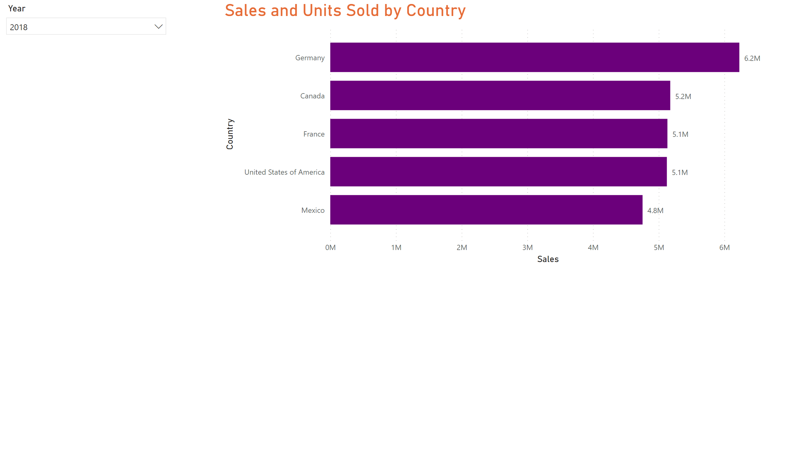
Sales By Country
Notes:
clusteredBarChart
This type of visual represents the data properly because it clearly represents such a large data set and also clearly labels the bars.

Slide 4
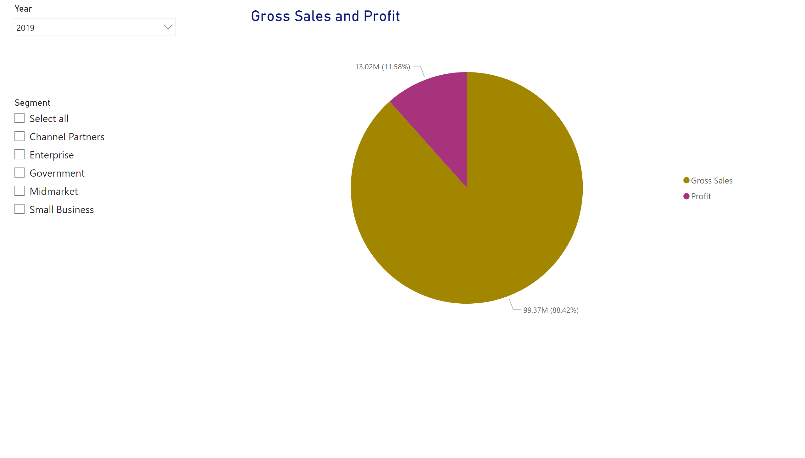
Gross sales & Profit by Segment
Notes:
pieChart
his visual type clearly represents percentages of the two elements with the use of colorful segments which altogether represent a whole.

Slide 5
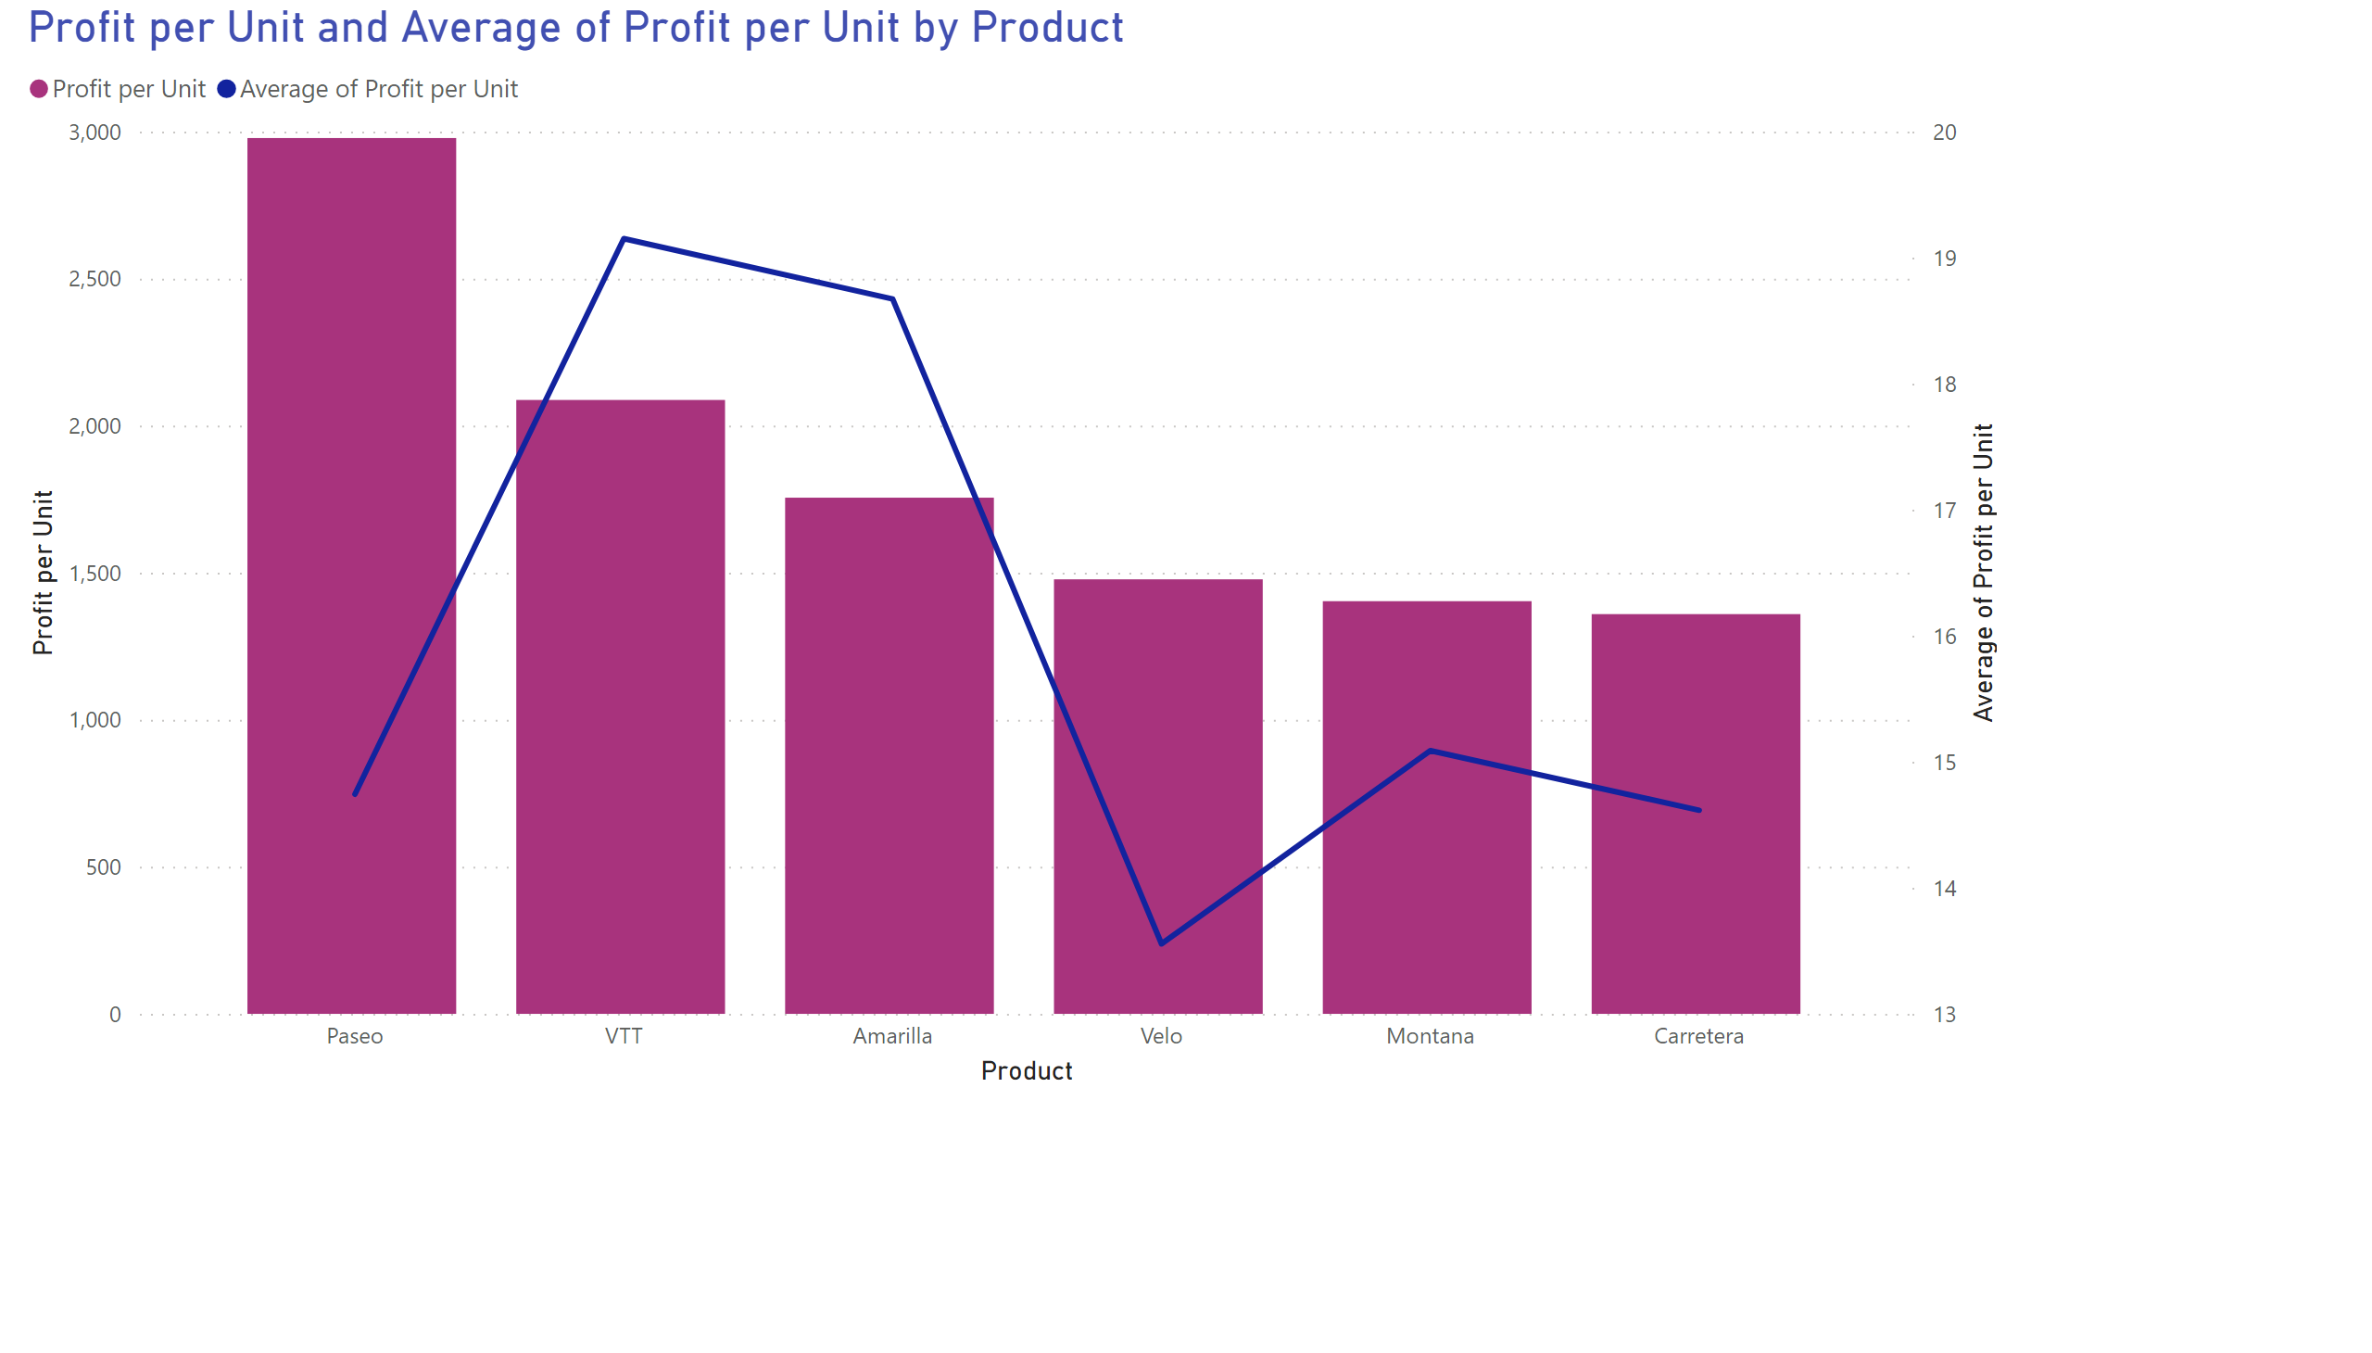
Profit per Unit by Product
Notes:
lineClusteredColumnComboChart
This combo chart visual allows a user to compare multiple measures with different value ranges and also Illustrate the correlation between two measures in one visual.

Slide 6
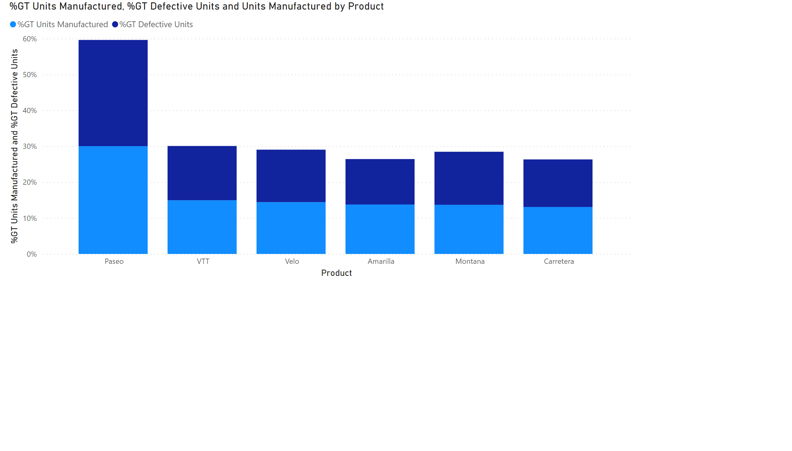
Units Manufactured & Defective Units by Product
Notes:
column chart
This visual shows two variables, units manufactured and those that are defective both stacked into one column

Slide 7
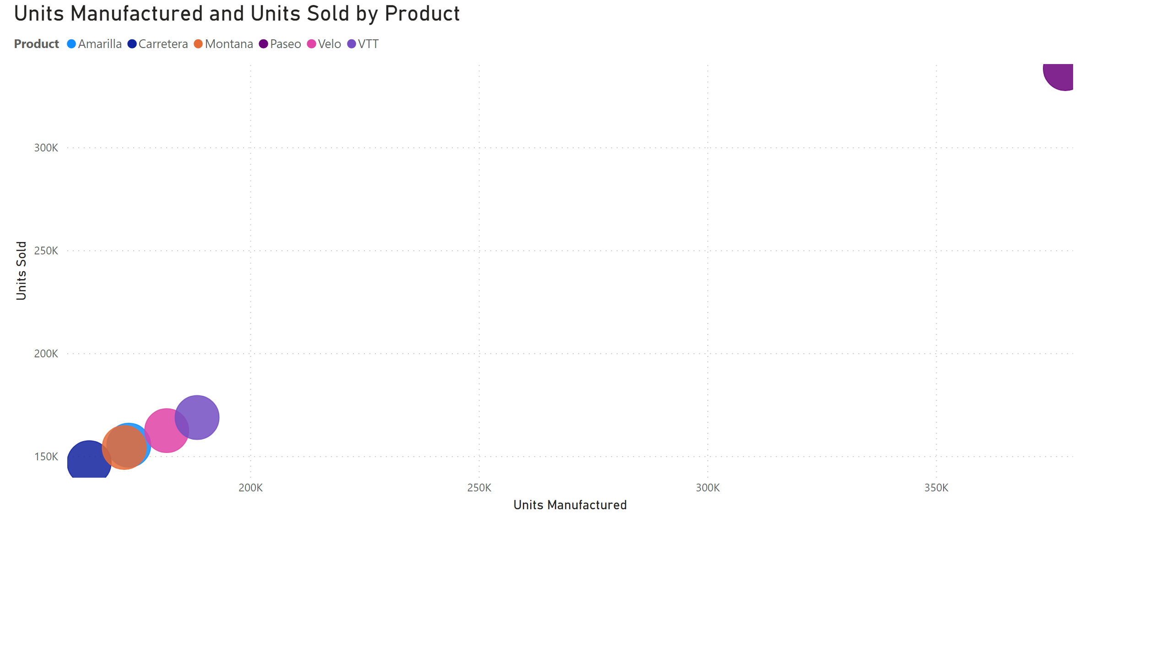
Units manufactured & Units sold Relationship
Notes:
scatter chart
This visual shows relationships between two numerical values.

Slide 8
Important Considerations
For stakeholders who are non-English speaking, the language preferences in the browser can be changed based on the language they are mostly comfortable with.
For stakeholders who are colorblind, there are several colorblind themes in Microsoft Power BI service, or I can import custom ones to design the most effective dashboards for them.

Slide 9
References
Microsoft. (2022). Choose an effective visualization. Developer tools, technical documentation and coding examples | Microsoft Docs. https://docs.microsoft.com/en-us/learn/modules/visuals-power-bi/3-effective-visualization

